Slide 1
Final Presentation Simply Siam --- iOS

Slide 2
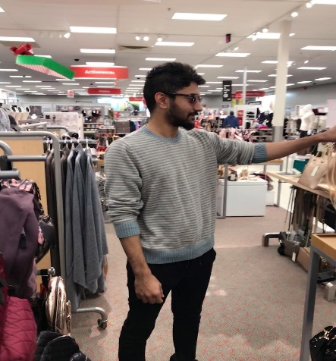
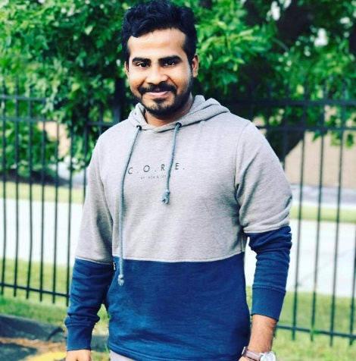



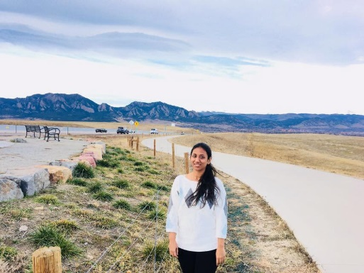
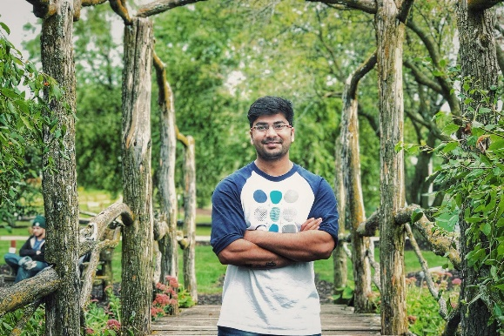
Team Members
Nikhil . K
Darshan
Nikhil . M
Lohita
Samyuktha
Snigda
Neelesh

Slide 3
Overview
Use Case Diagrams
Login page
Signup page
Profile update
Menu page
Menu Item Details
Cart page
Order Confirmation
Google Maps
Feedback Page
Database Connections

Slide 4
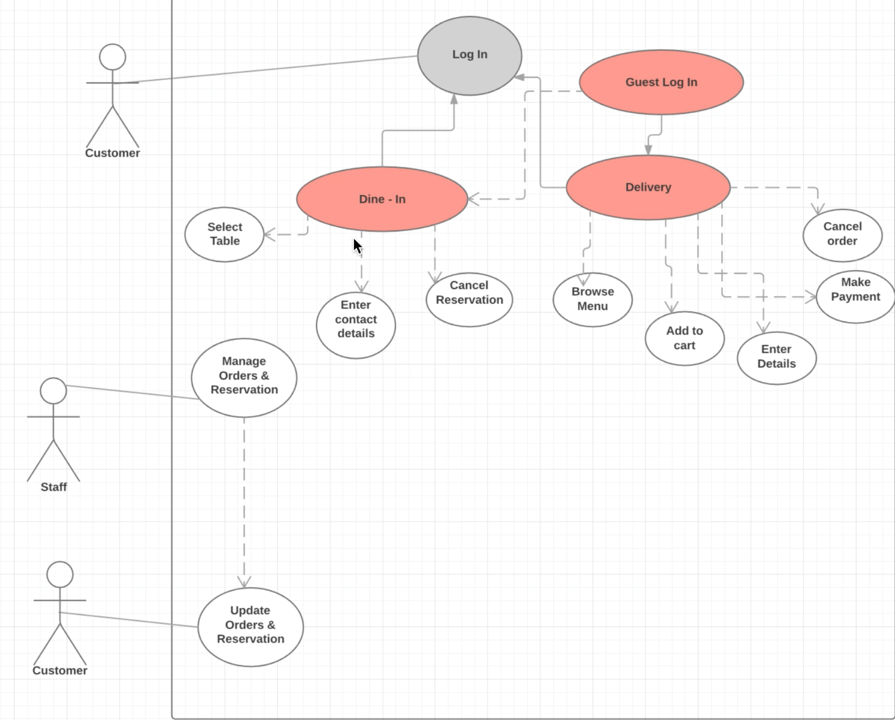

Slide 5
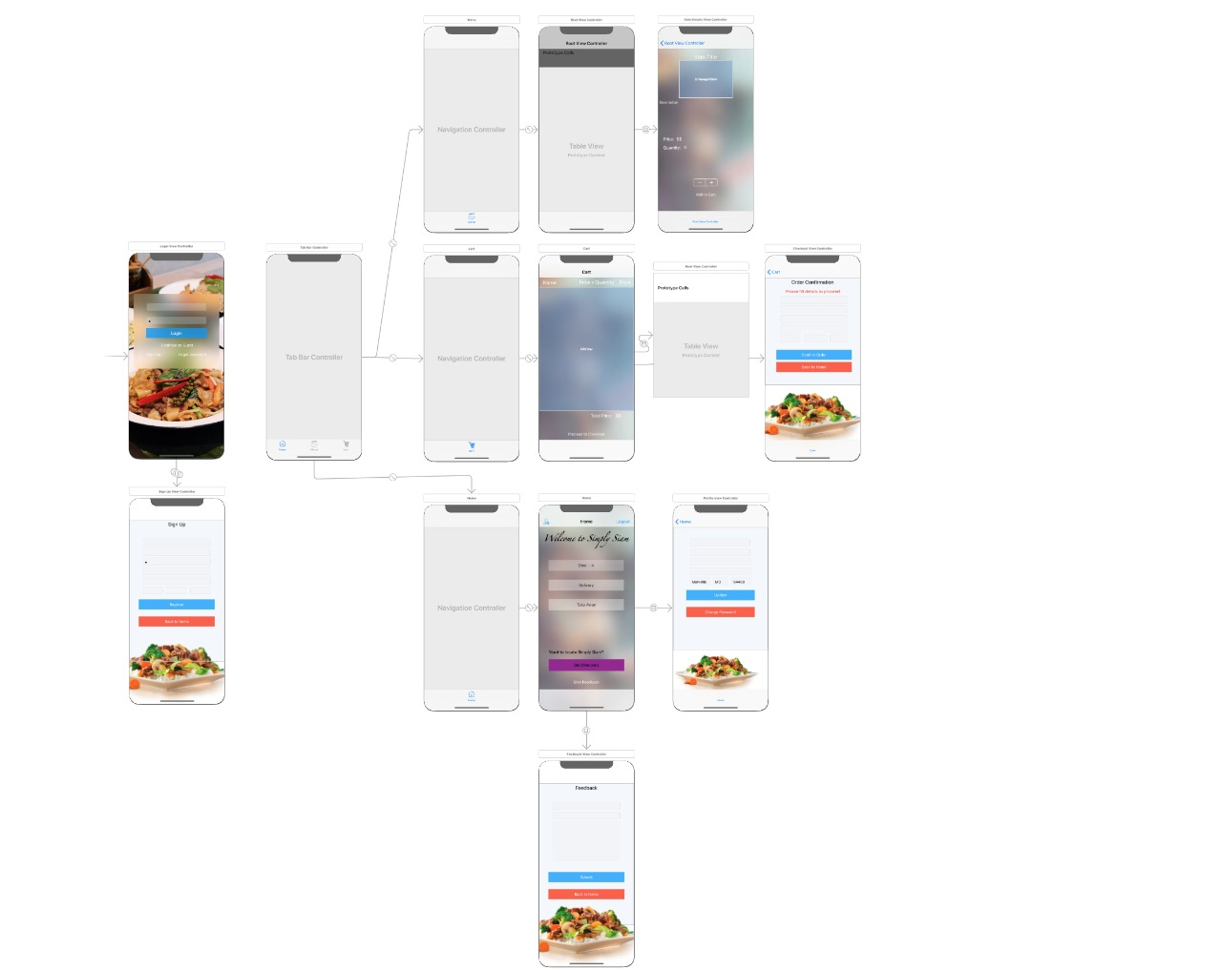

Slide 6
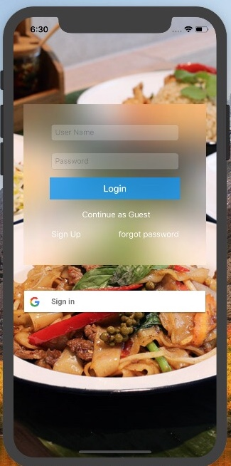
Login Page

Slide 7
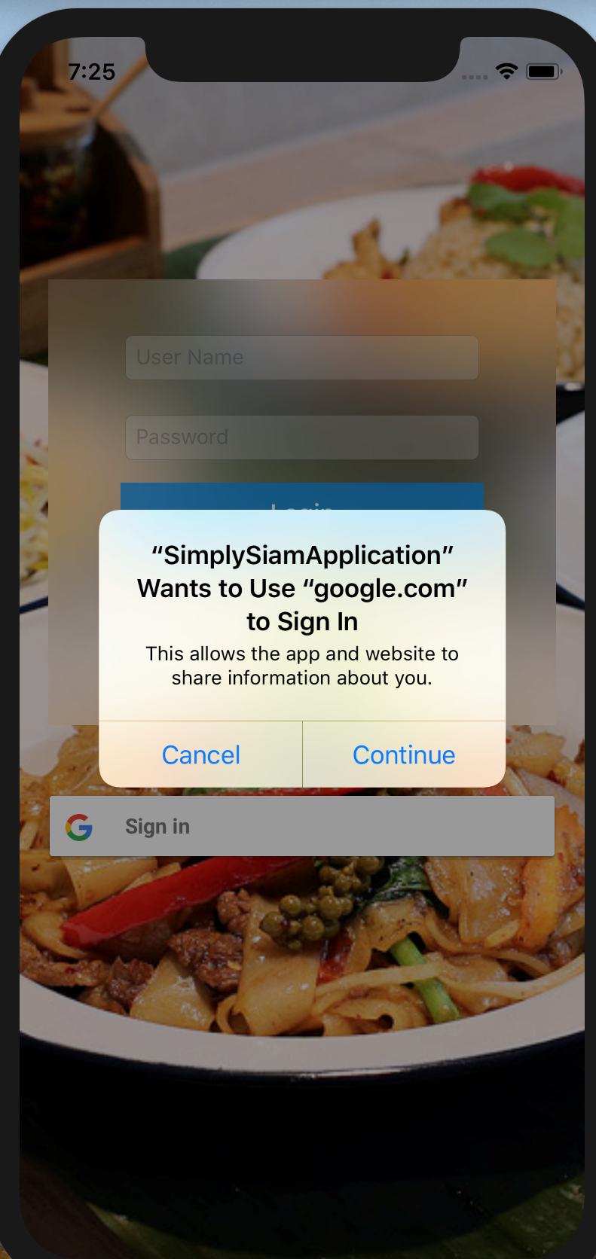
Google Log-In

Slide 8
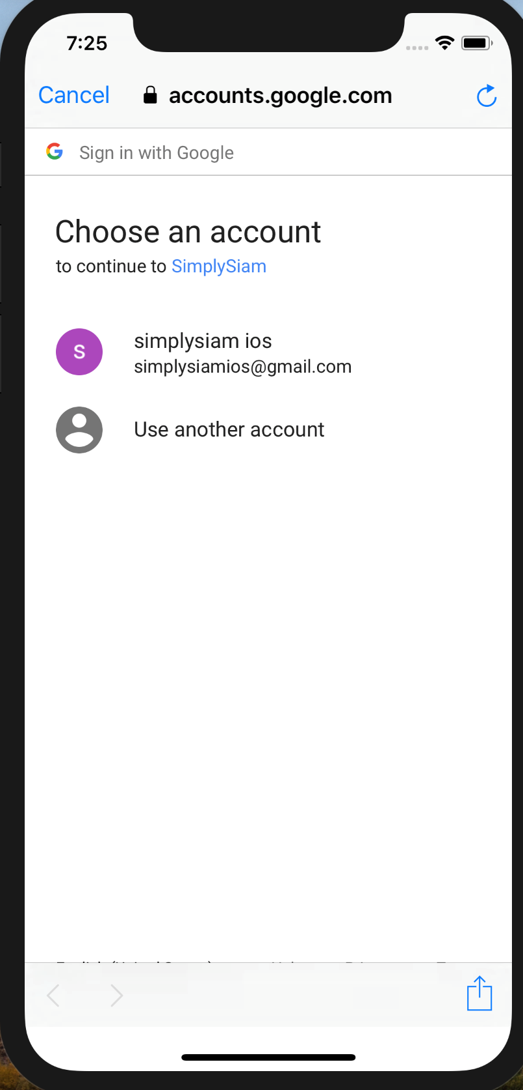
Googgle Log-In

Slide 9
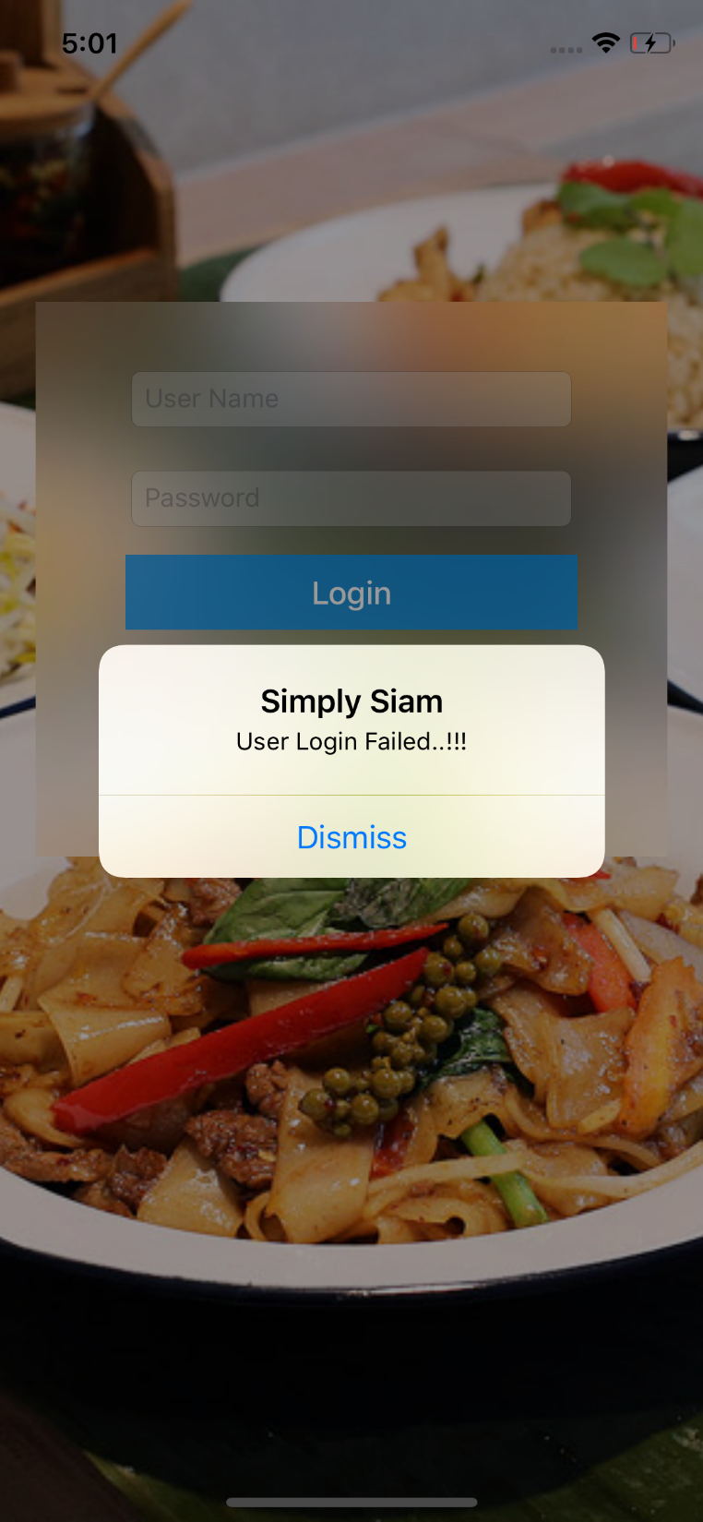
Login Failed

Slide 10
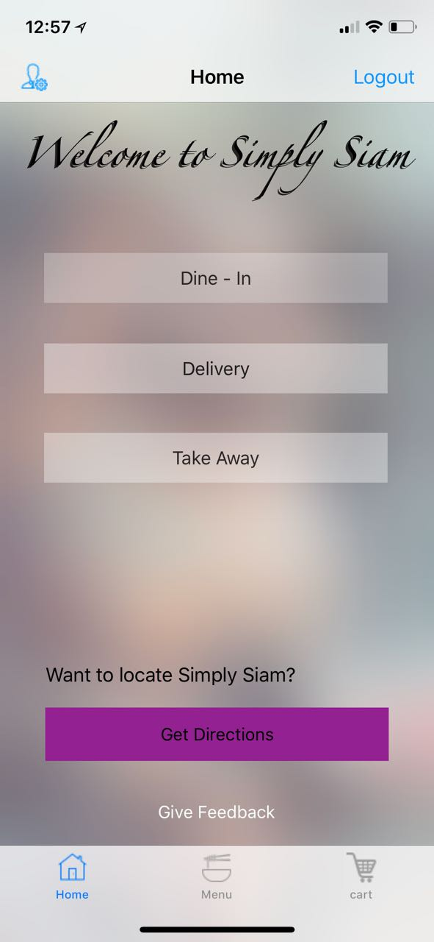
Welcome Page

Slide 11
Welcome Page
We have 3 options
Delivery
Take Away
Dining s

Slide 12
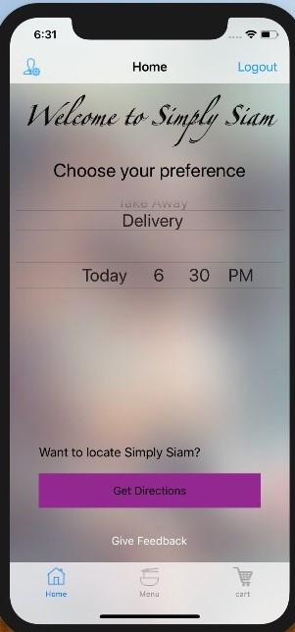
Delivery

Slide 13
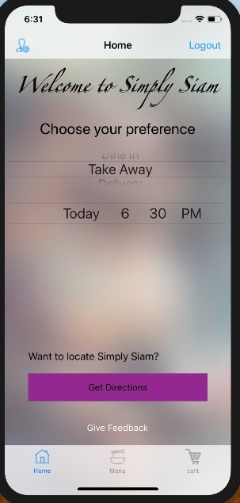
Take Away

Slide 14
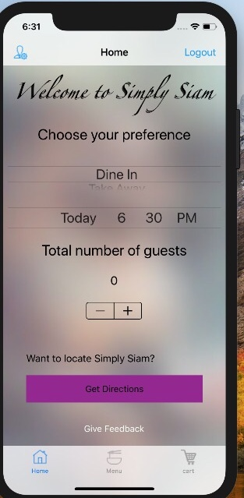
Dine -In

Slide 15
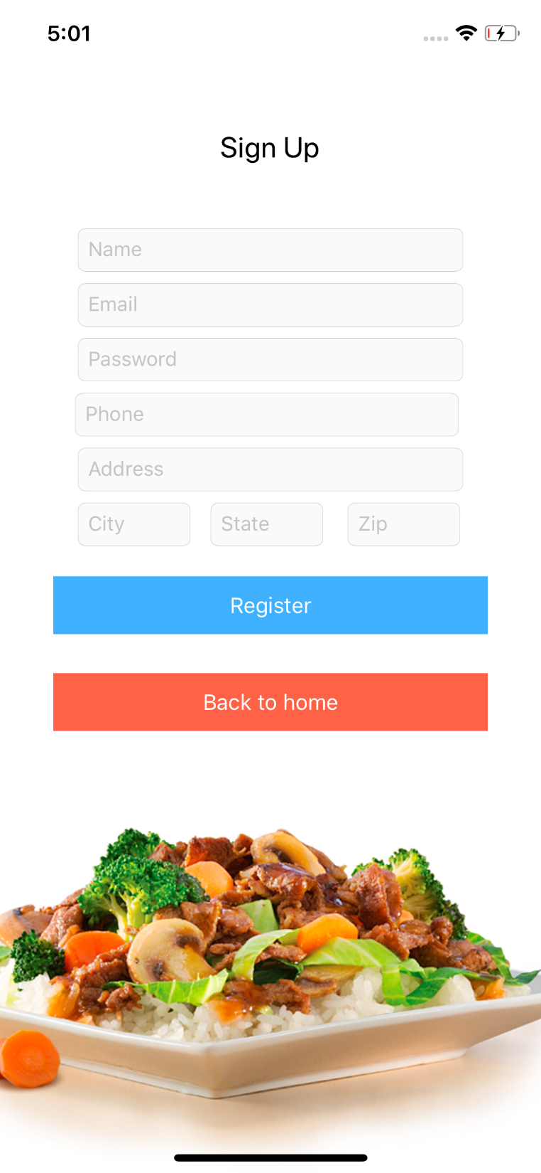
Signup page

Slide 16
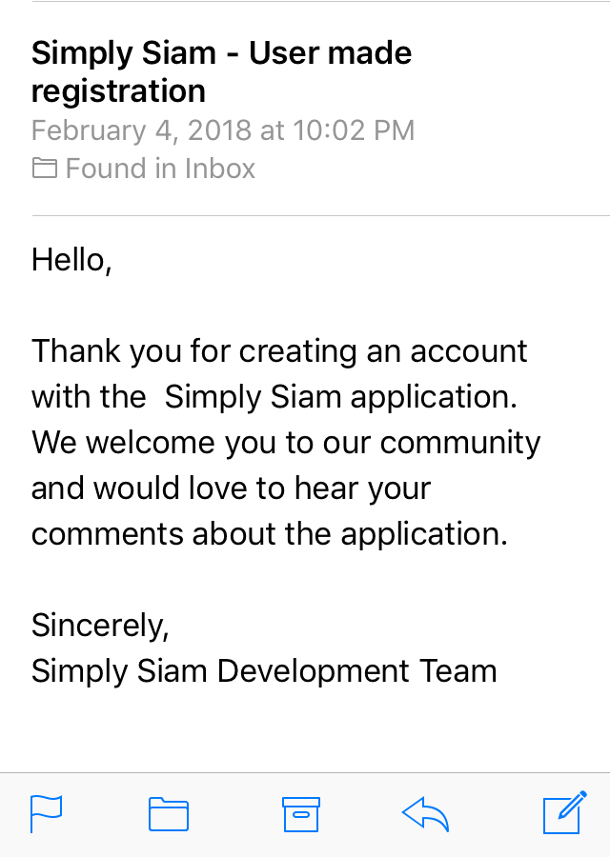
Confirmation -mail

Slide 17
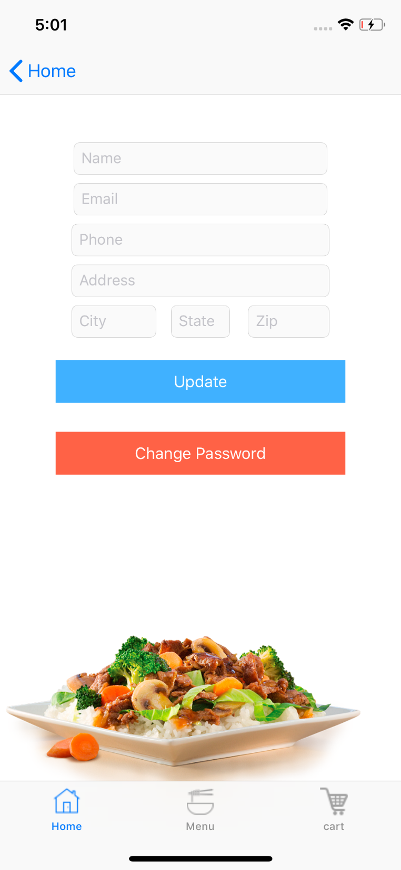
Update Page

Slide 18
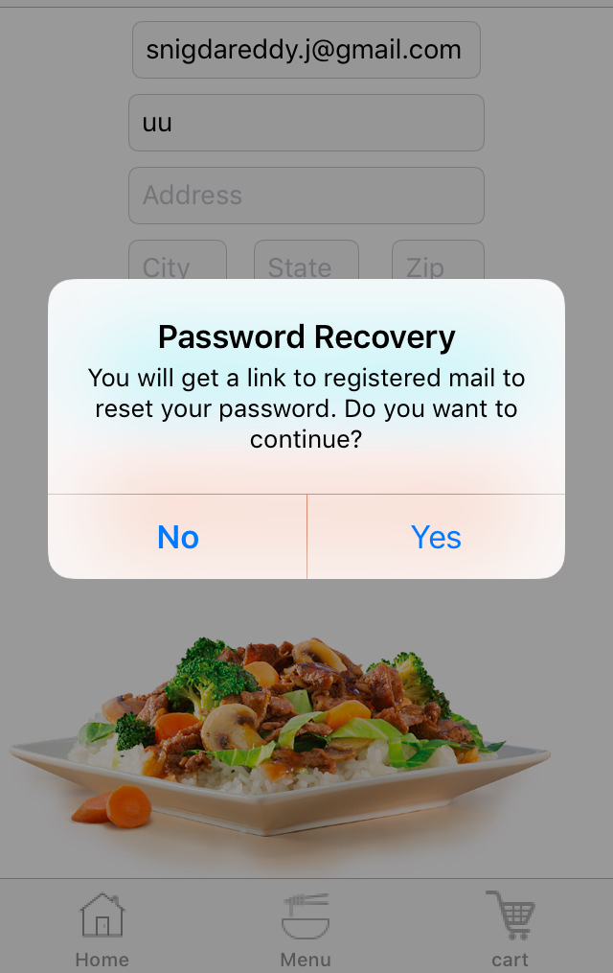
Update Password-Password Recovery

Slide 19
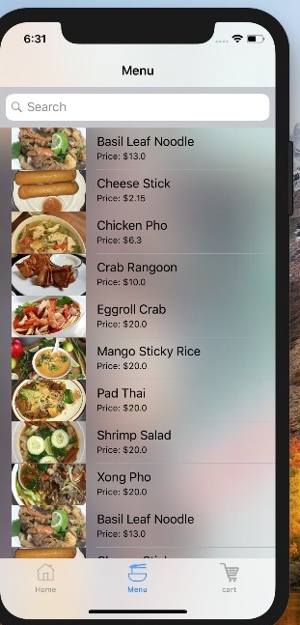
Menu page

Slide 20
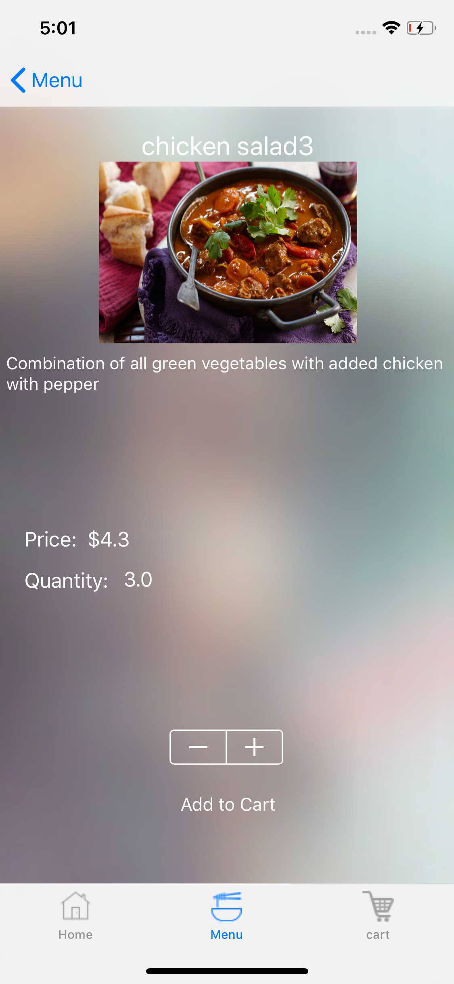
Menu Item Details

Slide 21
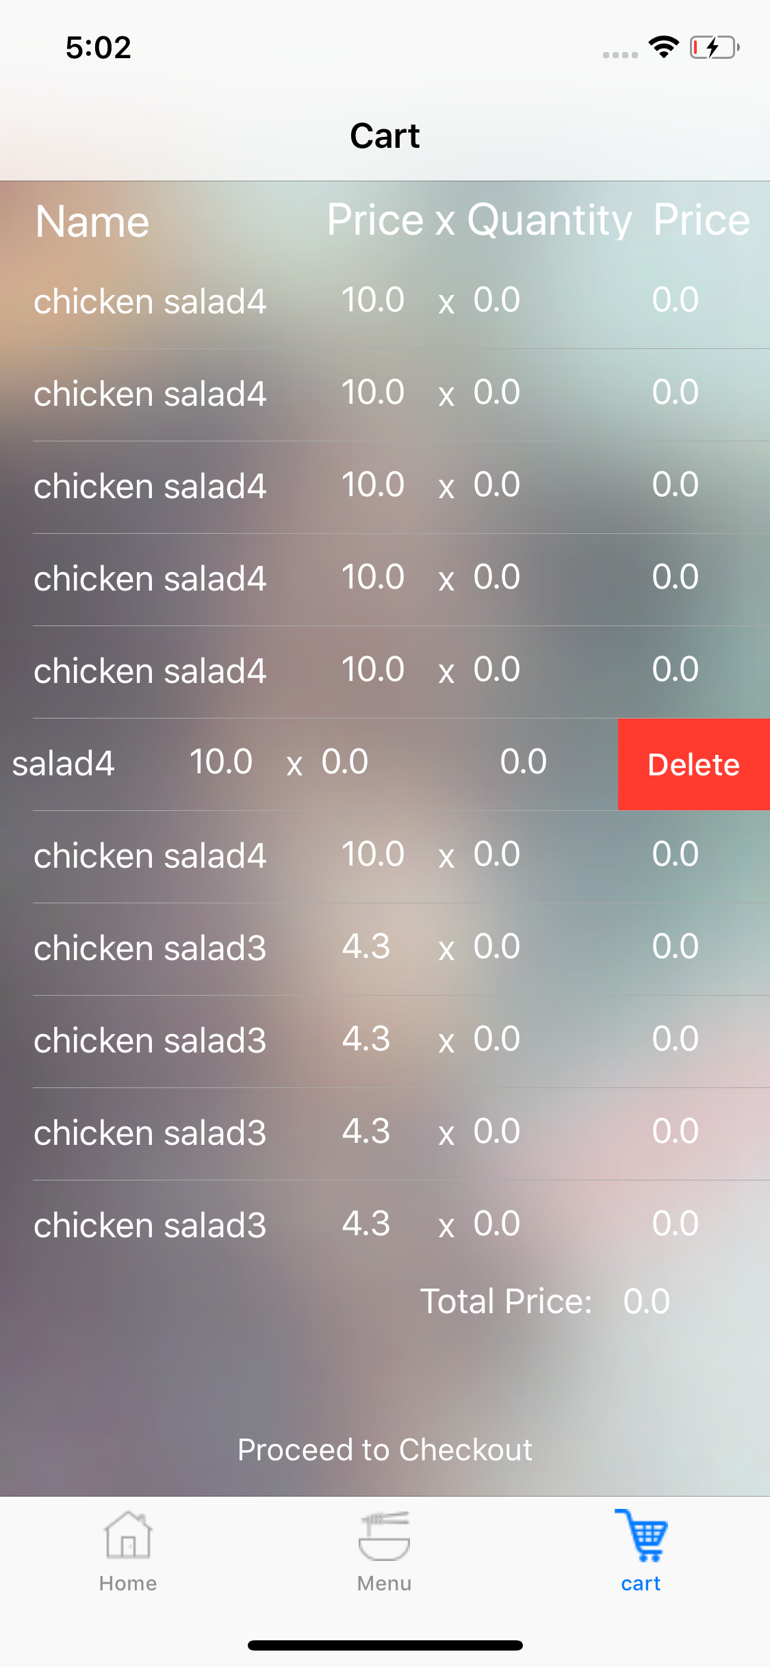
Cart

Slide 22
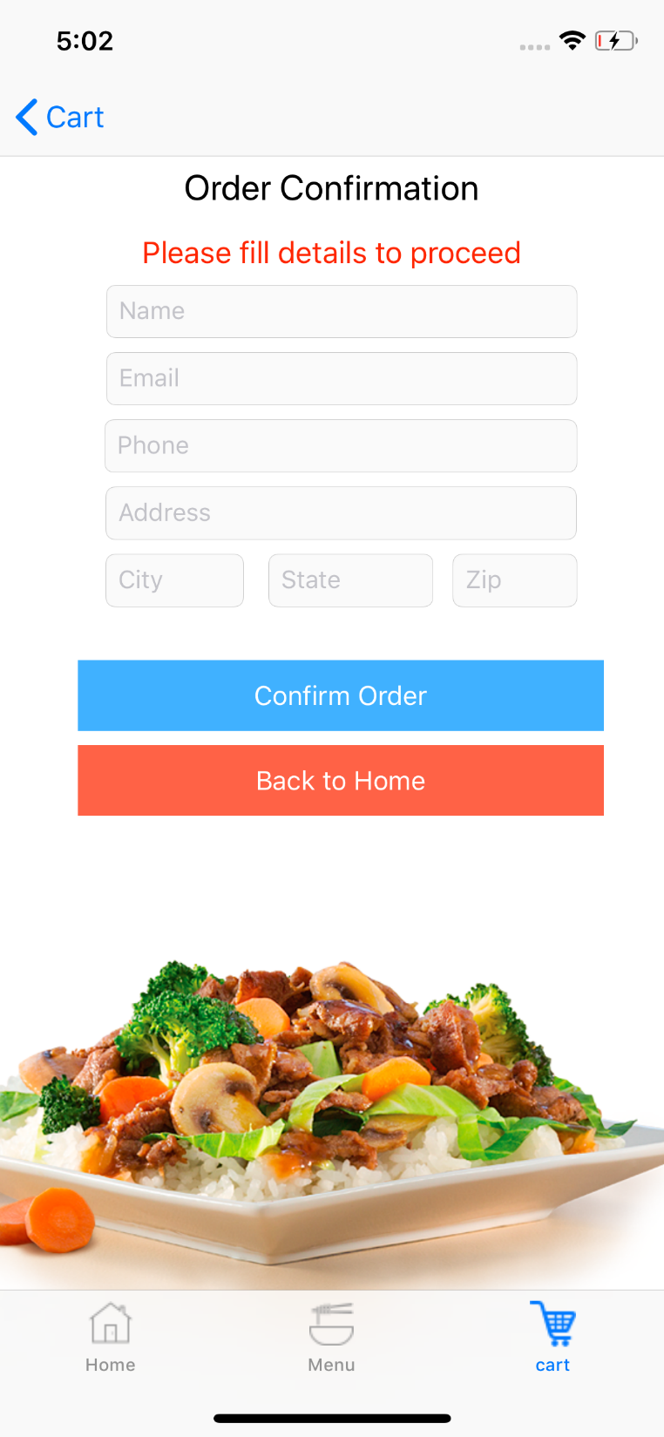
Order Confirmation

Slide 23
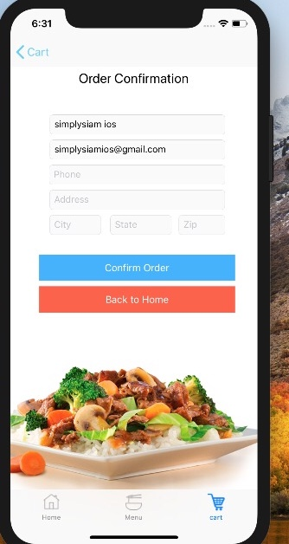
Order Confirmation

Slide 24
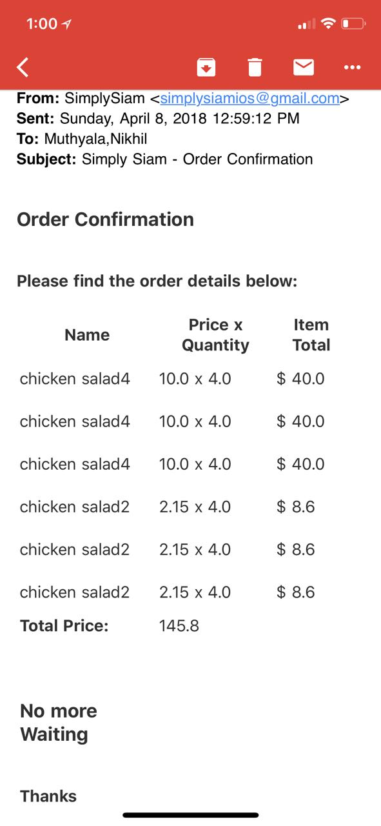
Order Confirmation Mail

Slide 25
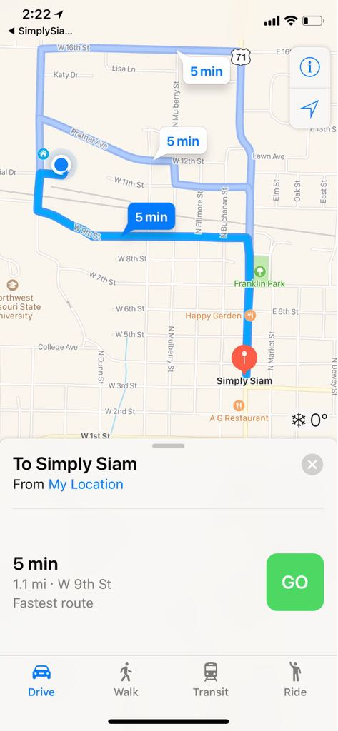
Google Maps

Slide 26
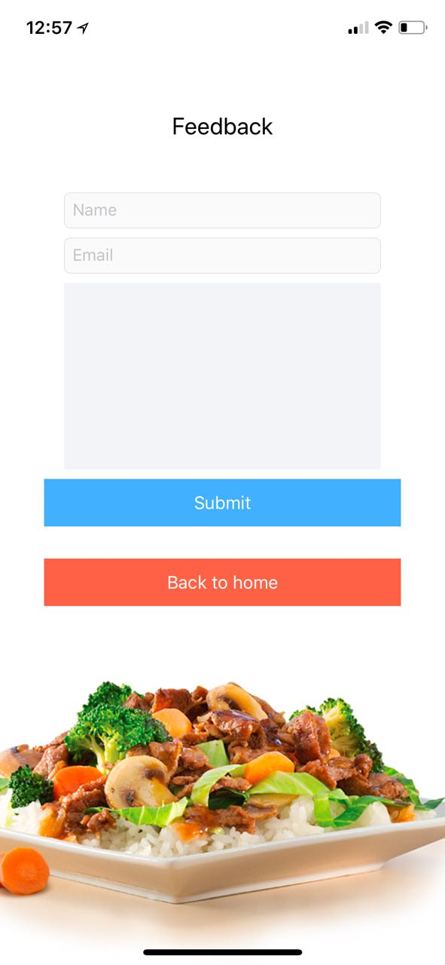
Feed Back Page

Slide 27
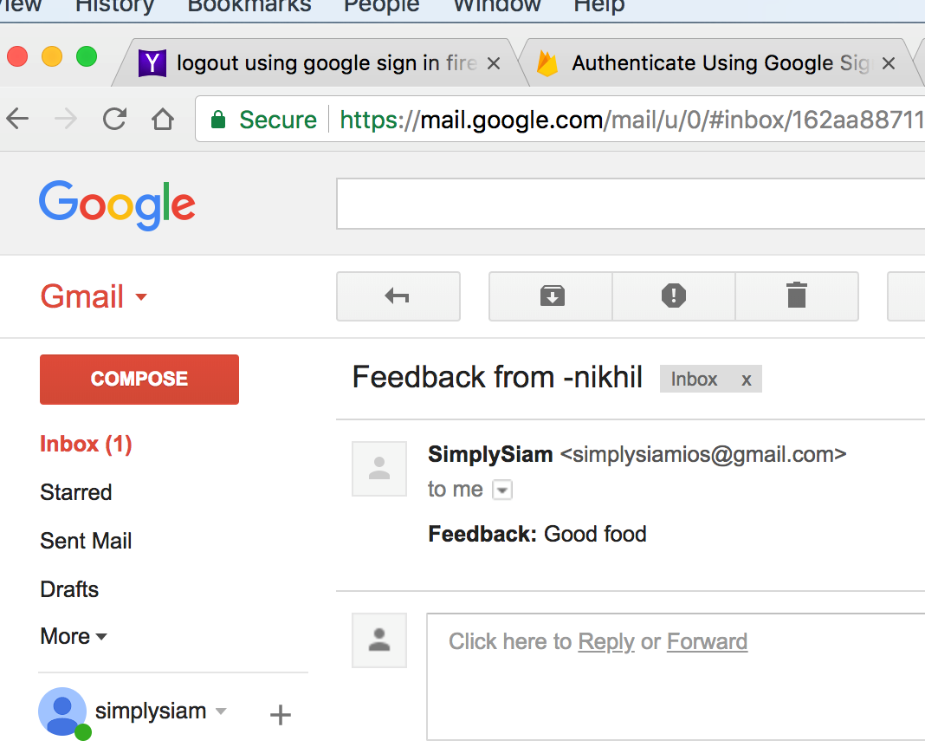
Feedback Page

Slide 28
Database
Backendless
Created tables
Need to populate data

Slide 29
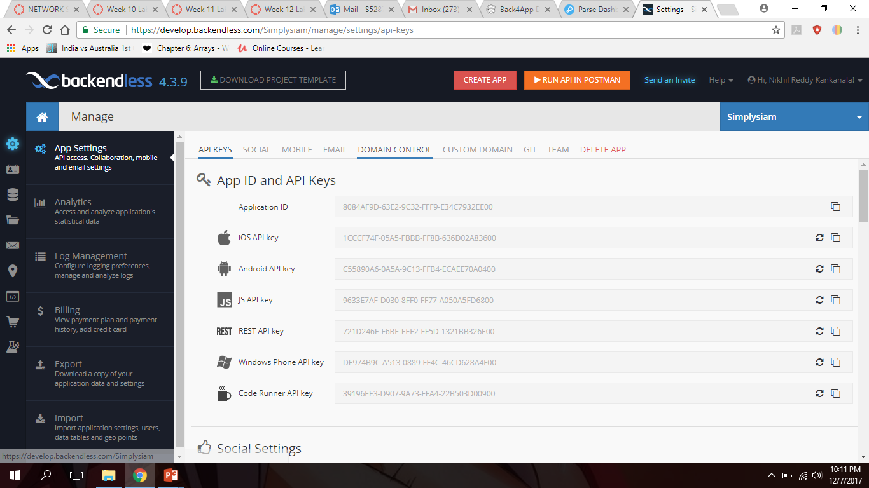
Backendless - Authentication

Slide 30
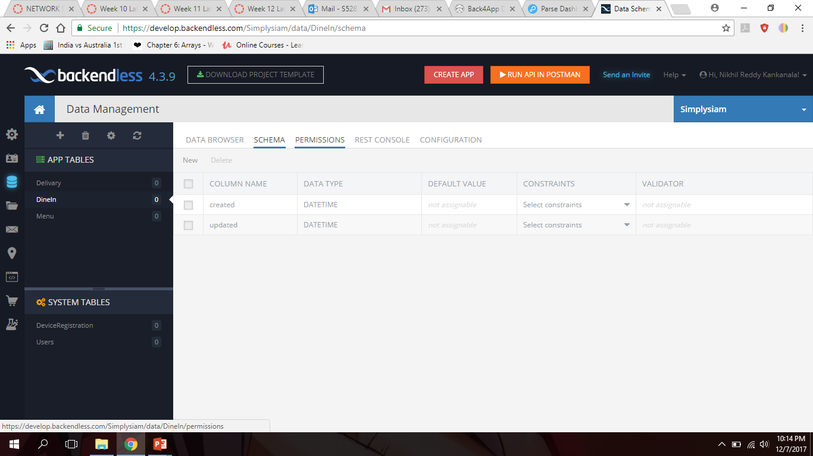
Backendless - Tables

Slide 31

Fire-Base

Slide 32
Questions?
Nikhil . K
Darshan
Nikhil . M
Lohita
Samyuktha
Snigda
Neelesh

Slide 33
Thank You

